Slide 1

Graph Theory and its Applications
Groups and substructures
Top down and bottom up
Dr. Arti Arya
Department of Computer Science
and Engineering

Slide 2

Graph Theory and its Applications
Top-down approach
Dr. Arti Arya
Department of Computer Science and Engineering

Slide 3
Graph Theory and its Applications Disclaimer
The course slides are prepared by Prof. BhaskarJyoti. But various major inputs are added by me from various reliable resources from Foreign and Indian Universities as well as from sites.
Notes:
Ok. Having said that, lets get back to what we were speaking about.
Input devices. We have seen that the virtual reality eco system largely encompasses three fundamental components that include
HMD – head mounted devices that give you immersive VR experience, we saw some examples in the last class like the HTC VIVE, Oculus Rift, Samsung gear and so on. Some of you have also used few of these and experienced it for a few minutes.
And the second components is the GTD or the Gesture Tracking Devices. We saw a video of Xsense IMU sensors that can accurately estimation the position and orientation of a dancer. we will in the next hour see how these gesture tracking devices work and what are the various technicalities that go into tracking. I will try to keep it as non-mathematical as possible, as the mathematics behind it can get pretty messy and complicated. However, if you are interested in the mathematical aspects, I will be more than happy to discuss.
On the screen you can see that a 3 directional coordinate system is depicted. The 3 primary axes of a 3d coordinate system is X, Y and Z axis. Hear I would like to know where, when and why in your past have you encountered 3 dimensional coordinate system.
Give some time to the students to ponder on
Ok, if I tell you, I have encountered 2 dimension in images, drawings, sketch and so on. While I have encountered 1 dimension when I want to know the temperature currently or current time or something like that. Similar, where and when have you encountered 3D, either consciously or subconsciously.
Explain the roll pitch and yaw concepts.
Degree of freedom

Slide 4
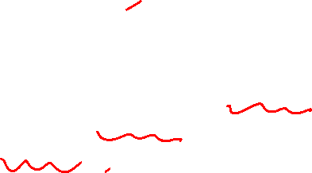
Graph Theory and its Applications
Two Approaches for Network Analysis
Two Approaches for Networks/Graphs Analysis
Top-Down Approach
Considering the whole network and then identify the substructures is top-down approach.
Looking for structural holes, vulnerabilities or weak ties/spots in the overall n/w
Top Down Approach
Bottom-up Approach
Tend to emphasize how the macro might emerge from the micro.
Tend to focus attention on individuals first and try to understand how they are embedded in the web of overlapping groups in the larger structure.
Bottom Up Approach

Slide 5
Graph Theory and its Applications
Two Approaches for Network Analysis
Two Approaches for Network Analysis
Top down approach
Weak Components
Strong Components
In Components
Out Components
Giant Component
Bottom-up approach
Cliques
N-clique
N-clan
N-club
N-core

Slide 6
Graph Theory and its Applications
Top-down approach
Division of Actors into groups and sub-structures can be a very important aspect of social structure.
It can be important in understanding how the n/w as a whole is likely to behave
We can look at sub structures from a view point of “top-down” approach.
Substructures are the areas of the graph that seem to be locally dense but separated to some degree from rest of the graph.

Slide 7

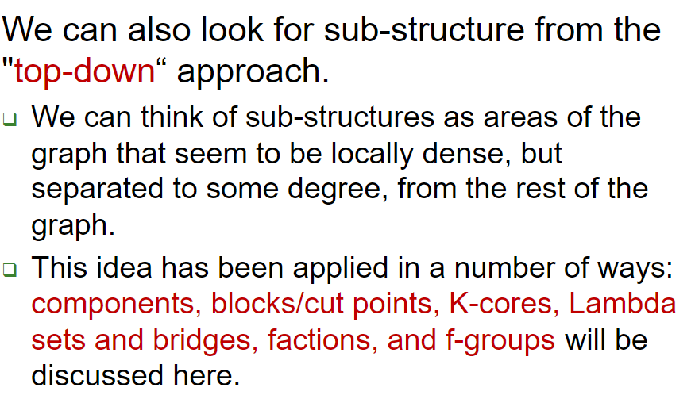
NETWORK ANALYSIS AND MINING
Top-down approach

Slide 8
Graph Theory and its Applications
Top-down approach
Starts with the entire network as the frame of reference, rather than the dyad and tend to look at the "whole" structure, and identify "sub-structures“.
They are looking for "holes" or "vulnerabilities" or "weak spots" in the overall structure of the network. These holes or weak spots define lines of division or cleavage in the larger group, and point to how it might be de-composed into smaller units.
This top-down perspective focus on the constraints
There are numerous ways that one might define the divisions and "weak spots" in a network.

Slide 9
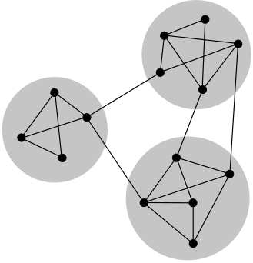
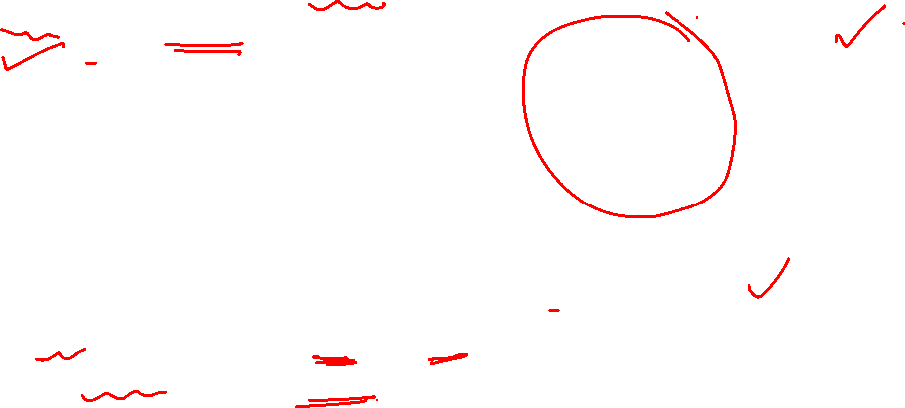
Graph Theory and its Applications
Undirected graph – connected and disconnected components
If there exists a path between any possible pair of vertices in a network then it is called connected
A network for which there exists pairs of vertices such that there is no path between them, is called disconnected
Component is a maximal subset of vertices of a network such that there exists at least one path from every vertex of the subset to any other vertex.
(Maximal because even one more node could not be found to add to the subgraph)

Slide 10
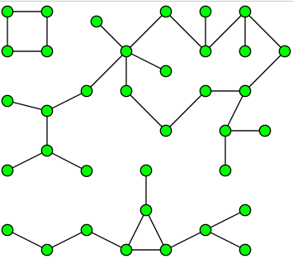
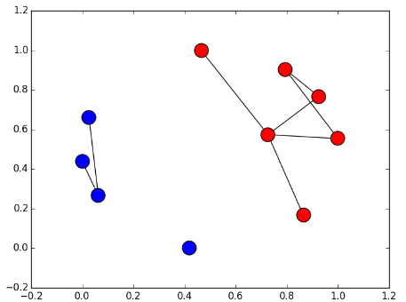
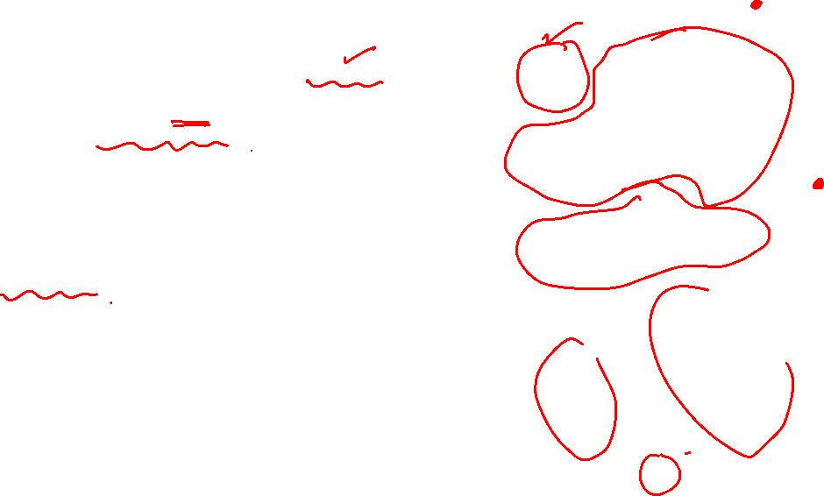
Graph Theory and its Applications
Directed graph – components ( weak and strong)
Components of a graph are sub-graphs that are connected within but disconnected between themselves.
If a graph contains one or more "isolates," these actors are components.
A disconnected graph may have components.

Slide 11
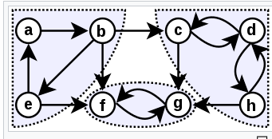
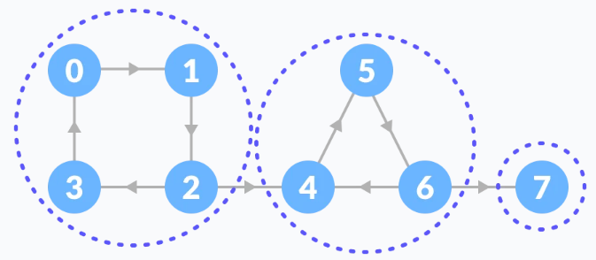
Graph Theory and its Applications
Directed graph – components ( weak and strong)
For directed graphs (in contrast to simple graphs), we can define two different kinds of components.
A strong component requires that there be a directed path from A to B in order for the two to be in the same component

Slide 12
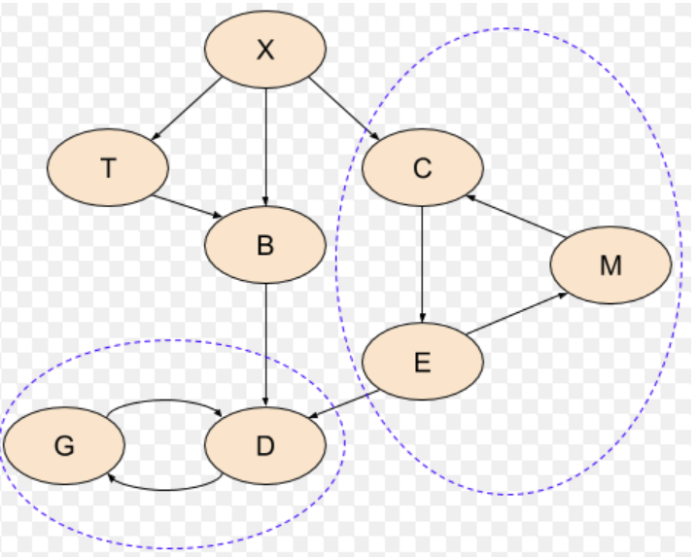
Graph Theory and its Applications
Directed graph – components ( weak and strong)
For directed graphs (in contrast to simple graphs), we can define two different kinds of components.
A strong component requires that there be a directed path from A to B in order for the two to be in the same component
Strong Component

Slide 13
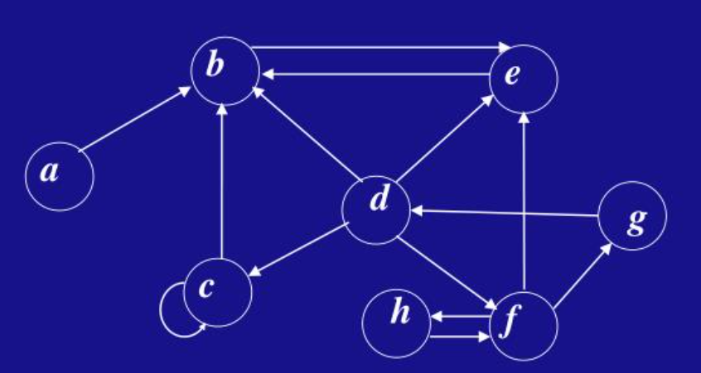
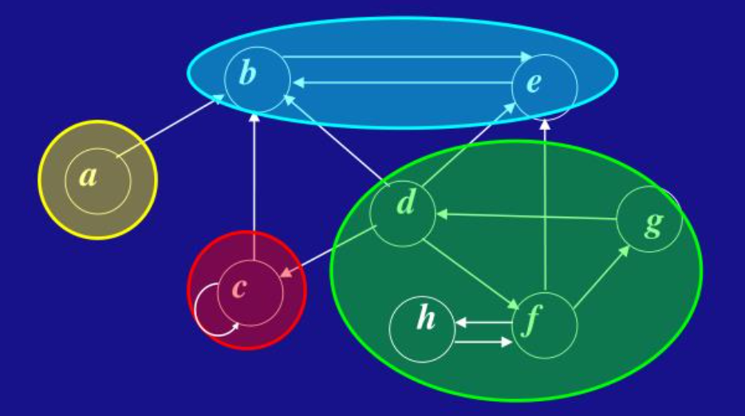
Graph Theory and its Applications
Directed graph – components ( weak and strong)
For directed graphs (in contrast to simple graphs), we can define two different kinds of components.
A strong component requires that there be a directed path from A to B in order for the two to be in the same component

Slide 14
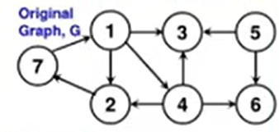
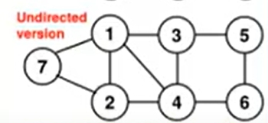
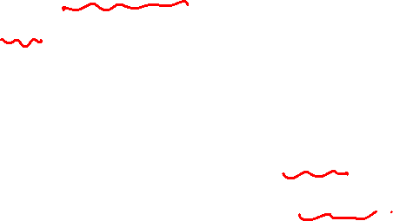
Graph Theory and its Applications
Directed graph – components ( weak and strong)
For directed graphs (in contrast to simple graphs), we can define two different kinds of components.
A weak component is a set of nodes that are connected, regardless of the direction of ties.
All the vertices are reachable from each other in the undirected version, so all 7 vertices are said to form a weakly connected component for the directed graph.

Slide 15
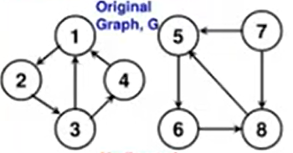
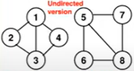
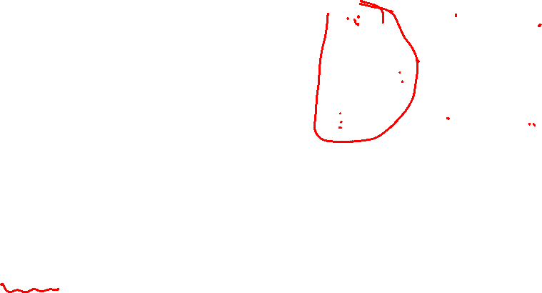
Graph Theory and its Applications
Directed graph – components ( weak and strong)
For directed graphs (in contrast to simple graphs), we can define two different kinds of components.
A weak component is a set of nodes that are connected, regardless of the direction of ties.
Vertex sets {1,2,3,4} and {5,6,7,8} are two weakly connected components

Slide 16
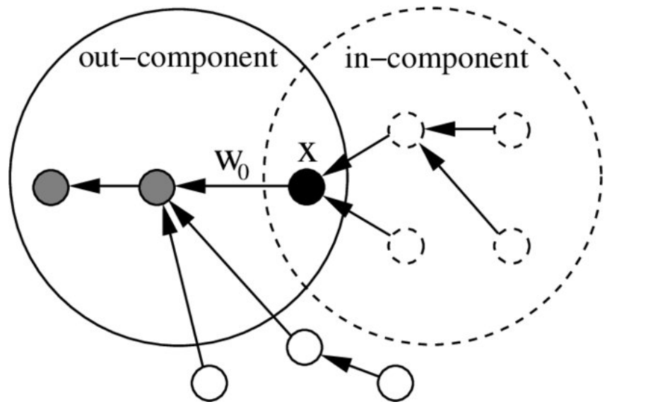
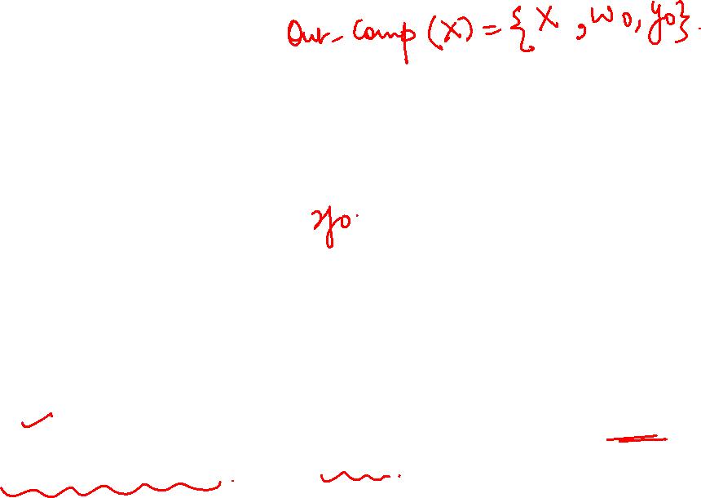
Graph Theory and its Applications
Directed graph : Out components
The set of vertices that are reachable via directed paths from node X (including X), form its out-component
Out-component is a property of both the network and the starting vertex
Hence, a vertex can belong to more than one out-components
In this example, the out-component of X has size 3 (node X itself belongs to its in and out components).

Slide 17

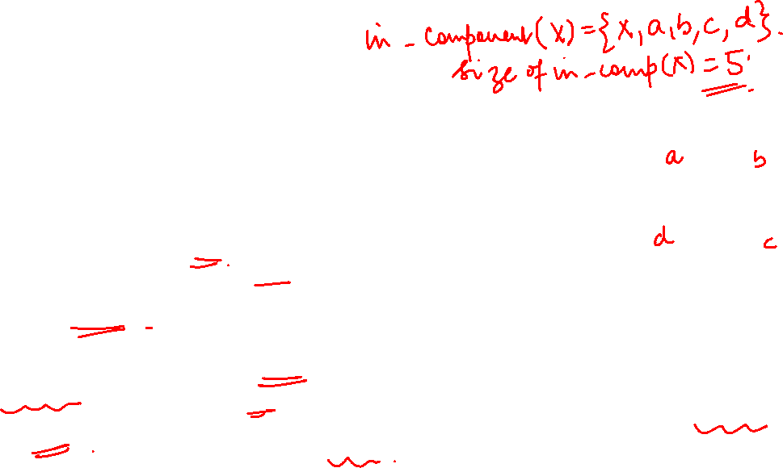
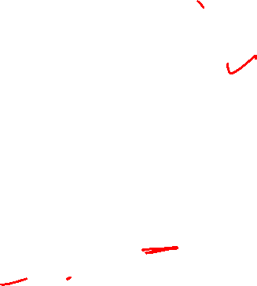
Graph Theory and its Applications
Directed graph : In components
The in-component of a specific vertex X is the set of all vertices (including X) from which there is a directed “path” to X
All the members of a strongly connected component have the same in-component.
All members of the strongly connected component that X belongs to, are members of its out-component
In this example, the in-component of X has size 5 (node X itself belongs to its in and out components).

Slide 18
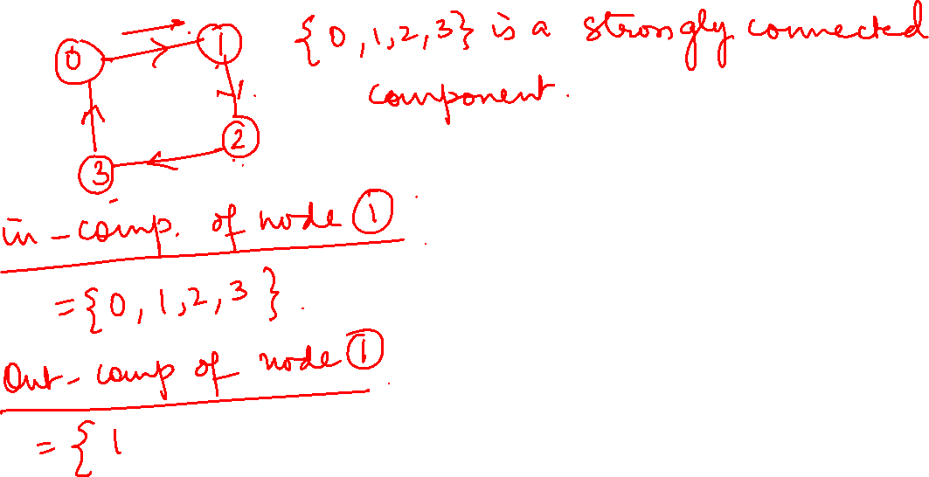
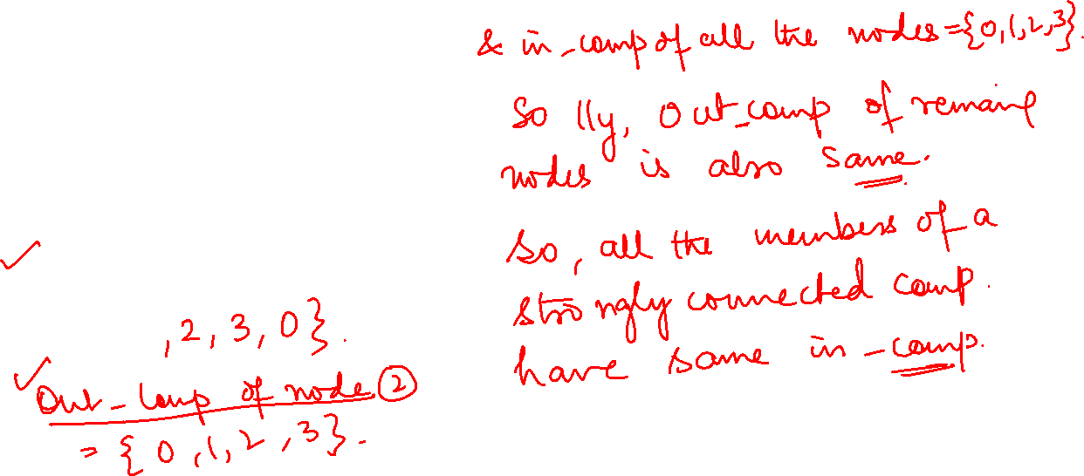

Slide 19
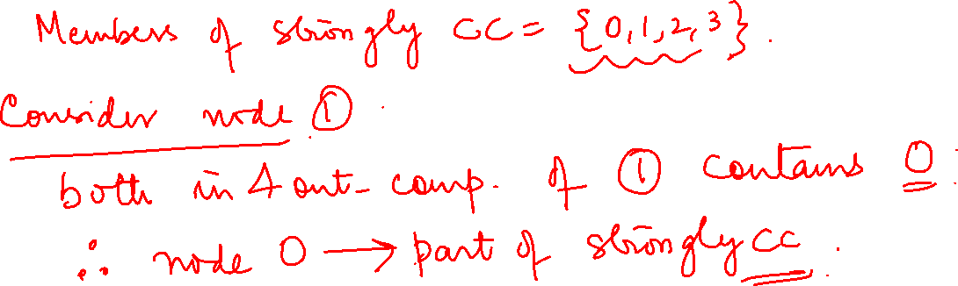

Slide 20
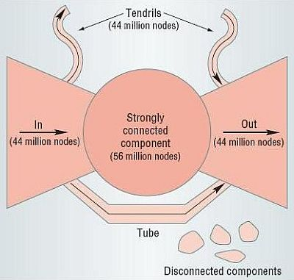
Graph Theory and its Applications
Bowtie in a large directed graph (web ?)
Directed graphs have weakly and strongly connected components.
Associated with each strongly connected component is an out-component (the set of vertices that can be reached from the strongly connected component but that cannot reach it) and an in-component (the set of vertices that can reach the strongly connected component but are not reachable from it).
If a node would belong to both the in and out component of a strongly connected component, then that node would be part of the strongly connected component.
Web graph is directed and forms a bowtie

Slide 22

Graph Theory and its Applications
Bowtie in a large directed graph (web ?)
Web graph contains a giant component that consists of three distinct components of almost equal size:
the CORE, made up of a single strongly connected component;
the IN set, comprised by nodes that can reach the CORE but cannot be reached by it;
the OUT set, consisting of nodes that can be reached by the CORE but cannot reach it.
These three components form the well known bow-tie structure of the Web graph.
https://www.cis.upenn.edu/~mkearns/teaching/NetworkedLife/broder.pdf

Slide 23
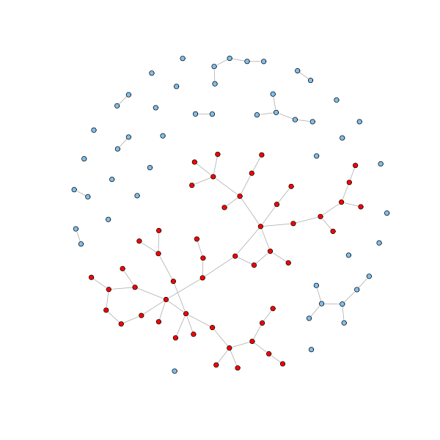
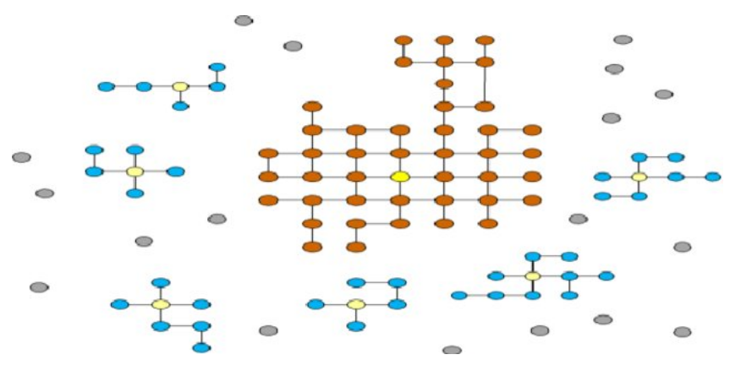
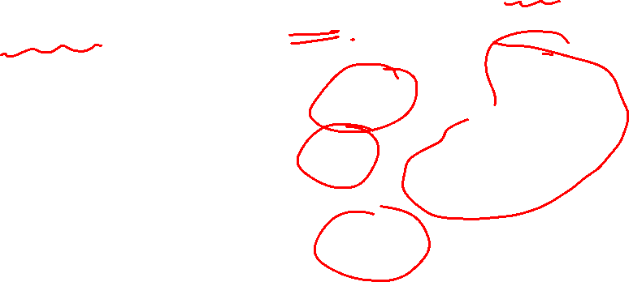
Graph Theory and its Applications
Giant component
In real undirected networks, we typically find that there is a large component (the giant component) that fills most of the network - usually more than half and sometimes over 90% - while the rest of the network is divided into a large number of small components disconnected from the rest.

Slide 24

Graph Theory and its Applications
Why giant component happens ?
According to Albert-László Barabási most complex networks evolve as a result of preferential attachment.
Preferential attachment (also known as the “rich get richer” principle) suggests that when a new node joins a network, it is likely to attach itself to a node with the highest degree.
Thus, the degree of the node with the highest degree becomes even higher, and the connected component that contains that node grows faster than all other connected components, leading to the emergence of the GCC.
If no such giant component, maybe it is not too realistic !

Slide 25
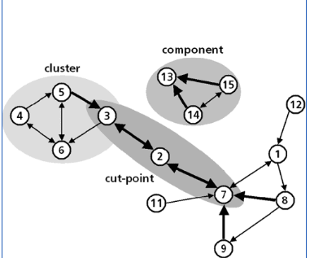
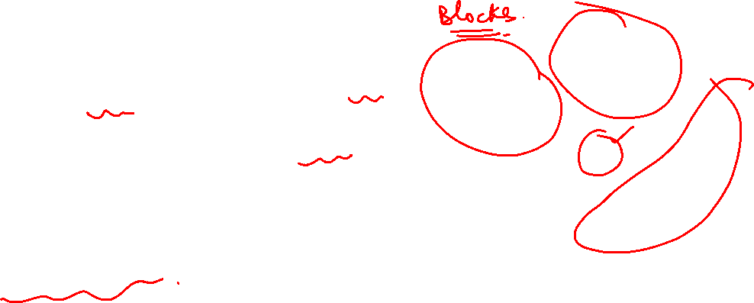
Graph Theory and its Applications
Top-down Approach: Blocks and cut points
An alternative approach to finding the key "weak" spots in the graph is to ask: if a node were removed, would the structure be divided into un-connected parts?
If there are such nodes, they are called "cut points." And, one can imagine that such cut points may be particularly important actors -- who may act as brokers among otherwise disconnected groups.
The divisions into which cut-points divide a graph are called blocks.

Slide 26
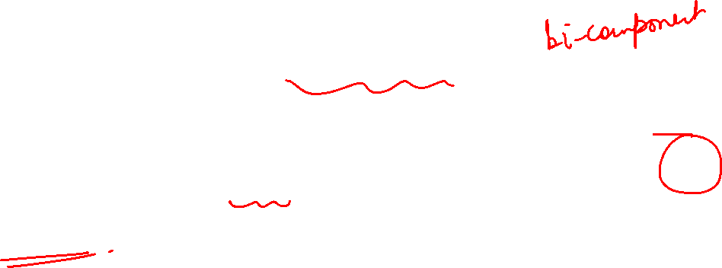
Graph Theory and its Applications
Blocks and cut points
We can find the maximal non-separable sub-graphs (blocks) of a graph by locating the cut points.
Another name for a block is a "bi-component.“
Components analysis locates parts of the graph that are disconnected
Bi-components analysis locates parts of the graph that are vulnerable.

Slide 27
Graph Theory and its Applications
Bottom-up approach

Slide 28



Graph Theory and its Applications
Bottom-up approach
How dense connections are built-up from simpler dyads and triads to make more extended dense clusters -- "bottom up" approach.
One of the most common interests of structural analysts is in the "sub-structures" that may be present in a network.
This approach focusses on how larger structures are Constructed from smaller ones

Slide 29
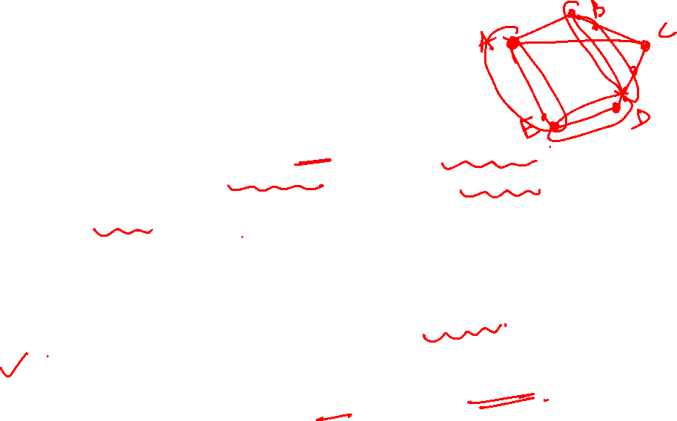
Graph Theory and its Applications
Clique
Clique is a maximal subset of the vertices in an undirected network such that every member of the set is connected by an “edge” to any other vertex i.e. every two vertices are adjacent
Cliques can overlap → they can share one or more vertices
People form "cliques" on the basis of age, gender, race, ethnicity, religion/ideology, and many other things.
The smallest "cliques" are composed of two actors: the dyad.
A clique indicates a highly cohesive subgroup
What is the difference between a Clique and a Complete Graph ?
Note : maximal means the largest possible
the set A has property P ; if B is another set with property P, and if B contains A, then B must be equal to A.

Slide 30
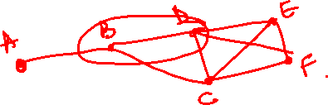
Graph Theory and its Applications
Maximum and Maximal Clique
Maximum Clique – with the largest number of vertices
Maximal Clique – No more nodes can be added to this Clique with clique definition not getting violated
We can search for components in the graph by searching for Maximum Clique which is by definition Maximal
Finding a clique is a NP HARD problem ( both maximum and maximal ) - algorithm has to generate all possible cliques and check for its existence
Cliques are rare in real world graph. A graph with n nodes may have ^{n}C₂ edges and removal of any one of them will violate clique conditions.
For checking clique existence, we have to check for all values of n where clique is possible.

Slide 31
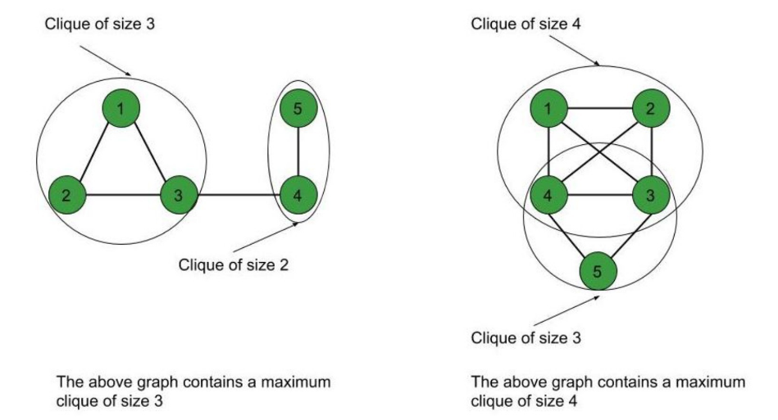
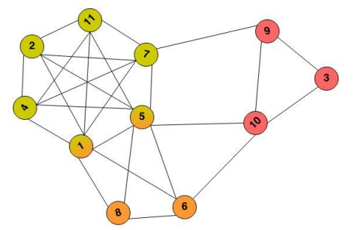

Slide 32
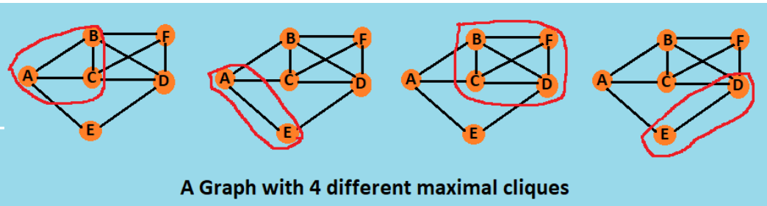
A maximum clique (i.e., clique of largest size in a given graph) is therefore always maximal, but the converse does not hold.

Slide 33
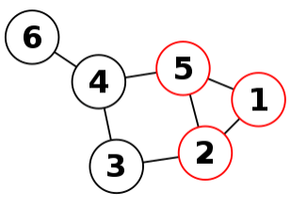
Graph Theory and its Applications
Maximum and Maximal Clique
Determine how many maximum cliques and how many maximal cliques?
Ans: 1 maximum clique(1,2,5)
And 5 maximal cliques (2,3), (3,4), (4,5), (4,6), (1,2,5)
Is (2,3,4,5) not a maximal clique?
Nope bcoz (2,3,4,5) is not a complete graph.

Slide 34
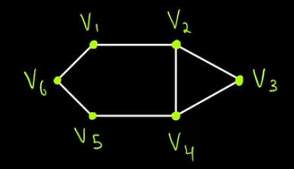
Graph Theory and its Applications
Maximum and Maximal Clique
Q: Is (V2, V3) a clique? If yes, is it maximal?
Ans: it a clique which is a dyad.
Not maximal bcoz we can add V4 to it to make a triad or clique

Slide 35
Graph Theory and its Applications
Issues with clique
Recap : Insisting that every member of a clique be connected to every other member is a very rigid definition of what we mean by a group.
There are a number of ways in which this restriction could be relaxed. Two major approaches are
the N-clique/N-clan (in terms of the link between 2 members) approach
the k-plex/k-core approach (in terms of # of members a member is connected with)

Slide 36
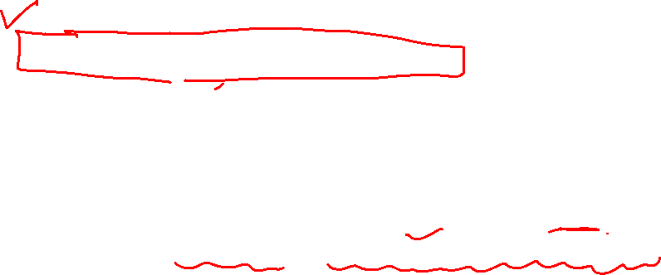
Graph Theory and its Applications
N-Clique or K-Clique
Recap : Most of the real groups have at least a few members who don’t know each other. Hence, the clique condition is relaxed.
Any subset S of nodes in which the geodesic path between every pair of nodes {u, v} ε S is <=k (less than or equal to )
For n=1 this just covers ordinary cliques
N=2 corresponds to being "a friend of a friend.
{A,B,F} is 1-clique since every pair is adjacent
{ C,D,E} is a 2-clique since distance <= 2
{ B,C,D,E} is a 2-clique but not maximal
(also Consider B,E in B,C,D,E . What is the problem ?)
{F,B,C,D, E} is a maximal 2-clique ( adding A makes it
3 Clique)
{A,F, B,C,D, E} is a 3-clique ( i.e. <= 3)
B
C
D
A
F
E
Note that in K-cliques, nodes on the shortest path should not necessary be the part of the subgraph.

Slide 37
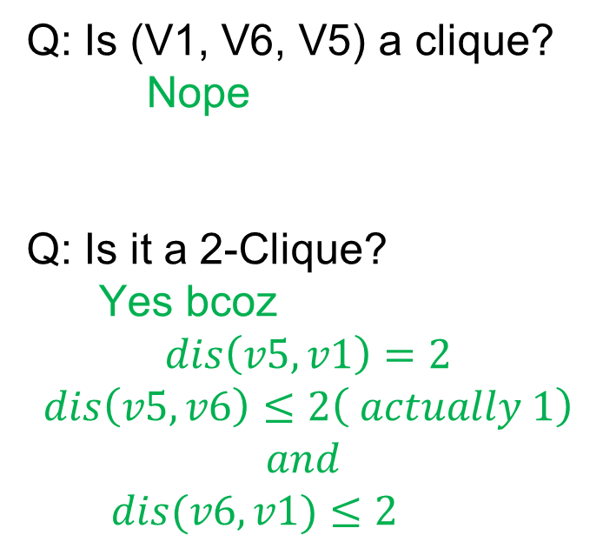
Graph Theory and its Applications
Maximum and Maximal Clique
Q: Is (V1, V6, V5) a clique?
Nope
Q: Is it a 2-Clique?
Yes bcoz
$$dis\left(v5, v1\right)=2$$
$$dis\left(v5,v6\right)≤2\left( actually 1\right)$$
$$and$$
$dis(v6,v1)≤2$

Slide 38
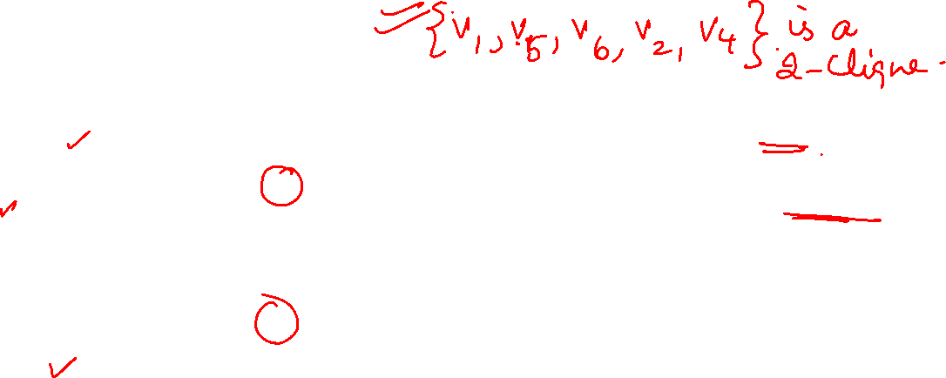
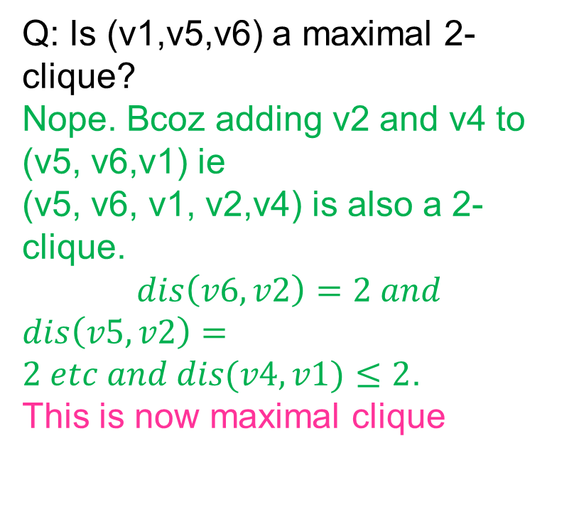
Graph Theory and its Applications
Maximum and Maximal Clique
Q: Is (v1,v5,v6) a maximal 2-clique?
Nope. Bcoz adding v2 and v4 to (v5, v6,v1) ie
(v5, v6, v1, v2,v4) is also a 2-clique.
$$dis\left(v6, v2\right)=2 and$$
$dis\left(v5,v2\right)=2 etc and dis(v4, v1)≤2$.
This is now maximal clique
Q: Is (v1,v2,v3,v4,v5,v6) a 3-clique?
Yes bcoz all vertices are at a distance of <=3 from each other.

Slide 39

Graph Theory and its Applications
Source of confusion
Sometimes N–clique is referred to as a 1-clique of N vertices ( shortest path distance = 1 hop).
As per the definition we learnt, N–clique is a clique where shortest path distance <= N.
K-cliques might not be as cohesive as they look. So, we may want to discuss k-clans.

Slide 40
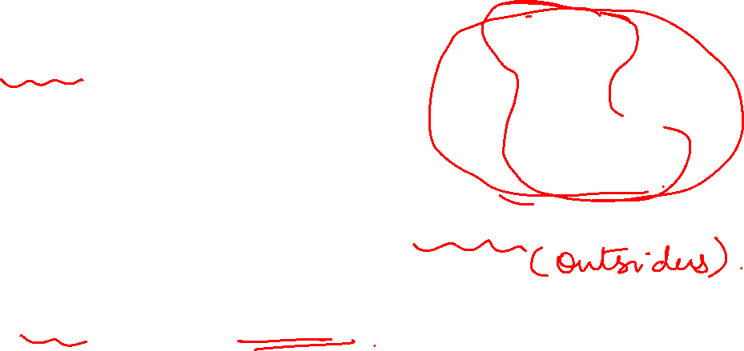
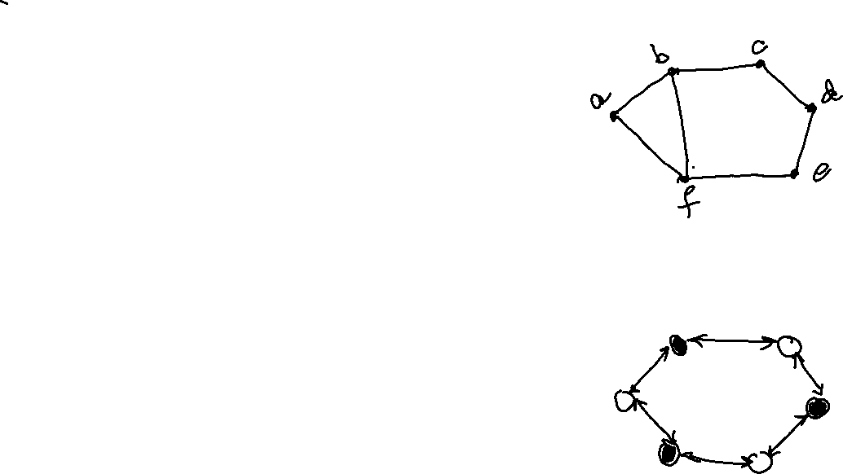
Graph Theory and its Applications
Issues with N-cliques
Overlapping
{a, b, c, f,e}
{b,c,d,f,e} are both 2 –cliques
Membership criteria satisfiable through non-members.
Even 2 –cliques can be fairly non-cohesive

Slide 41
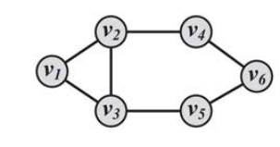
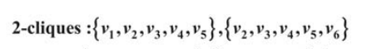
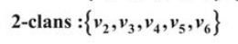
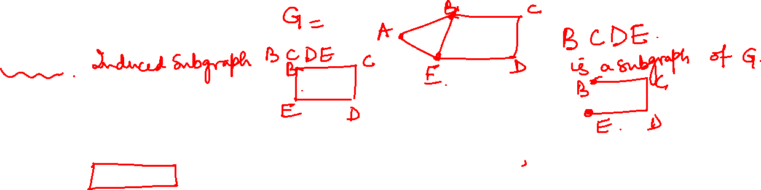
Graph Theory and its Applications
K-clan
K-clan: An N-clique in which the geodesic distance between nodes in the induced subgraph is no greater than n( ie <=n)
Members of set within n links of each other without using outsiders( outside nodes).

Slide 42
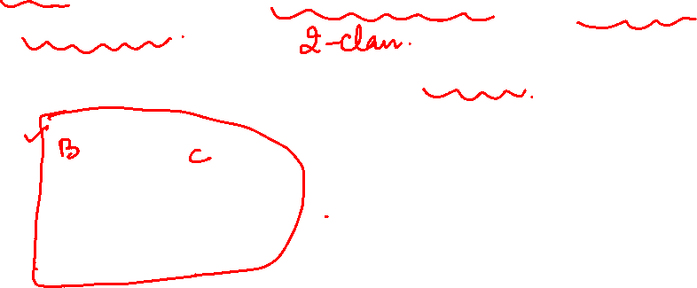
Graph Theory and its Applications
K Clan
Restricting K-cliques by insisting that the total span or path distance between any two members of a K-clique also satisfy a condition.
The condition requires that the all the ties among actors occur through other members of the group.
A k-clique in which the subgraph induced by set S has a diameter <= k
Here {B,C,D,E,F} will be a K clan with k=2 ( Refer to previous slide where we called {B,C,D,E,F} as a maximal 2-clique)
B
C
FYI
Diameter: the maximum distance between any pair of nodes in the graph.
Diameter is the maximum geodesic (shortest path)
If diameter is small, then everyone is fairly close to each other
Network is probably more cohesive
A
D
F
E

Slide 43



Graph Theory and its Applications
Induced Subgraph: FYI
6

Slide 44

Graph Theory and its Applications
Induced Subgraph: FYI

Slide 45


Graph Theory and its Applications
K plex
Let G=(V,E) be a graph. Then a subset S of V is a k-plex in G if
deg_{G[S]}(v) is at least |S|-k for every $v∈S.$
We may also say G is a k-plex if the minimum degree of G $≥\left|V\right|−k$
An alternative way of relaxing the strong assumptions of K-Clique is to allow that actors may be members of a clique even if they have ties to all but k other members.
k-plex of size n is a maximal subset of n vertices within a network such that each vertex is connected (by an edge) to at least n-k of the other vertices of the induced sub-graph
Notes:
or example, for k = 1, k-plexes are cliques as each node misses only the link to itself, for k=2, each node may miss the link to one neighbor (and itself), and so on

Slide 46
Graph Theory and its Applications
K plex
For example, in { A,B,C,D }, n=4 ; for k =2, n-k = 2
if A has ties with B and C, but not D; while both B and C have ties with D, all four actors could fall in clique under the K-Plex approach.
So, this is 2-plex of size 4
Similar to cliques, k-plexes can be overlapping
What kind of clique can be a 1-plex ?
B
A
D
C
Notes:
or example, for k = 1, k-plexes are cliques as each node misses only the link to itself, for k=2, each node may miss the link to one neighbor (and itself), and so on

Slide 47

Graph Theory and its Applications
K plex

Slide 48

Graph Theory and its Applications
K plex

Slide 49

Graph Theory and its Applications
K -core
A k-core is a maximal subgraph of nodes, such that each node in the subgraph has at least a degree k .
0-core is full graph
1-core is a graph with no isolate
2-core (at least 2 neighbors); hence no node makes a pendulum structure
Any graph usually has more than one core; the core with the largest possible k is called the main core of the graph.
The maximum k such that G has a k-core is the maximum core number of G.
Two k-cores cannot overlap, since then they would just form another k-core of larger size.

Slide 50


Graph Theory and its Applications
Finding the K -core

Slide 51

Graph Theory and its Applications
K -core
The subgraph of the k-core in which all nodes have exactly k neighbors in the core is called a k-corona.

Slide 52
Graph Theory and its Applications
Finding K Core
The standard algorithm to find a k-core graph is to remove all the vertices that have degree less than ‘K’ from the input graph.
Start with the original graph and remove all nodes that have a degree smaller than k and all the incident edges
This will probably result in some of the remaining nodes losing their neighbors with their degree decreased.
Some nodes that have k neighbors or more may have fewer than k neighbors after trimming; remove them, too, and iterate until no remaining node has fewer than k neighbors.
The remaining nodes form the k-core.

Slide 53

Graph Theory and its Applications
Find the 2-core
Originally the centre node has degree 5 and the rest have degree 1

Slide 54

Graph Theory and its Applications
K-crust and core-periphery structure
Core–periphery structures are commonly found in economic and social networks. They consist of a dense cohesive core and a sparse, loosely connected periphery
A k-crust is what is left of the original network when we remove the k-core. In other words, the crust is the periphery
A core has its internal structure. The subgraph of the k-core in which all nodes have exactly k neighbors in the core is called a k-corona.
Note : Given graph G and integer k, networkx has API for all these

Slide 55

THANK YOU
Dr Arti Arya
Department of Computer Science and Engineering

